Slide 1
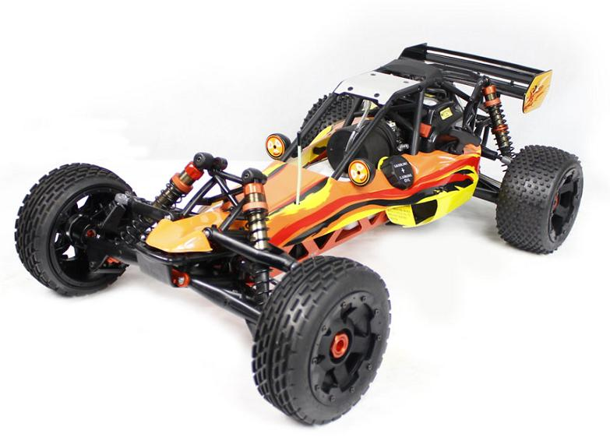


XLR8
Mechanical session

Slide 2
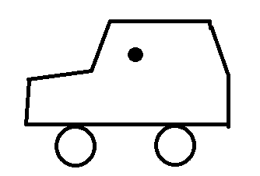
Center of Gravity
A lot of care must be taken about center of gravity.
The robot must be very stable and should be prevented from toppling , and other stability problems.
COG Height should be low, to avoid toppling while:
Negotiating inclines or jumping.
Facing Impulsive force at start of motion.
COG
COG
T = F*D
F(Pseudo force)
D

Slide 3
WHEELS
General size of wheels available in the market vary in size between 5-10cm in diameter.
Small wheel- lower top speed, higher acceleration.
Large wheel- higher top speed, lesser acceleration, difficulty in climbing incline.
Suggested to use wheels of 6cm diameter.
One should use wheels of same diameter both on the front and back if using same RPM motor to prevent unwanted friction produced due to different velocities of wheels.(power loss)

Slide 4
Four wheel drive
More number of motors = more torque.
Easy to climb inclined plane.
If not aligned properly in one plane one motor useless as it looses contact with ground.
Different RPM(with same diameter of wheel)
Front and rear different(Power loss as friction averages the speed)
Two sides different (Bot doesn’t move in straight line)
Suggested to use as it can easily climb inclines and easiest to make and control.

Slide 5
Three wheel drive
Minimum no of points to form a plane so very stable on any surface.(plane or terrain)
Wheels always in contact with the ground.
Only 2 motors
Less power consumption ☺ (Battery last long)
Less torque ☹ (Difficult to climb incline)
Bit difficult to make.

Slide 6
STEERING MECHANISM
Differential mechanism.
Axle mechanism.
Rack and pinion.

Slide 7
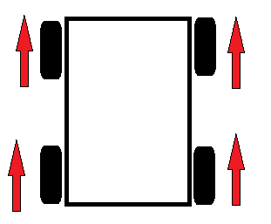
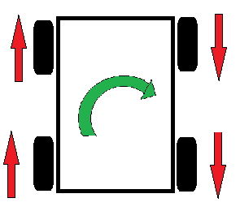
Differential
Car takes turn due to the relative motion between wheels.
Bot moves front.
Bot turns right.

Slide 8
Advantages of differential
Easy to make.
Easy to control.
No need to attach any new motors for steering.
Can take sharp and quick turns.

Slide 9
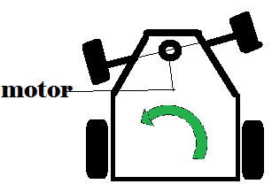
Axle mechanism
A motor placed vertically
turns the axle.
Bot can turn to any radius.
Motors are attached only to the rear wheels.
The motor used for turning must have very less rpm around 10-30 rpm.
usually not quick.
Accurate steering is not possible as motors don’t stop instantaneously when switched off.(Difficult to make small turns)

Slide 10
Rack and pinion
Stud mechanical design.
Similar thing used in actual cars!
Only 2 motors for power
Less power consumption ☺ (Battery last longer)
Less torque ☹ (Difficult to climb incline)
One motor for steering.
Very challenging!

Slide 11
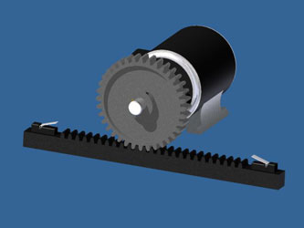
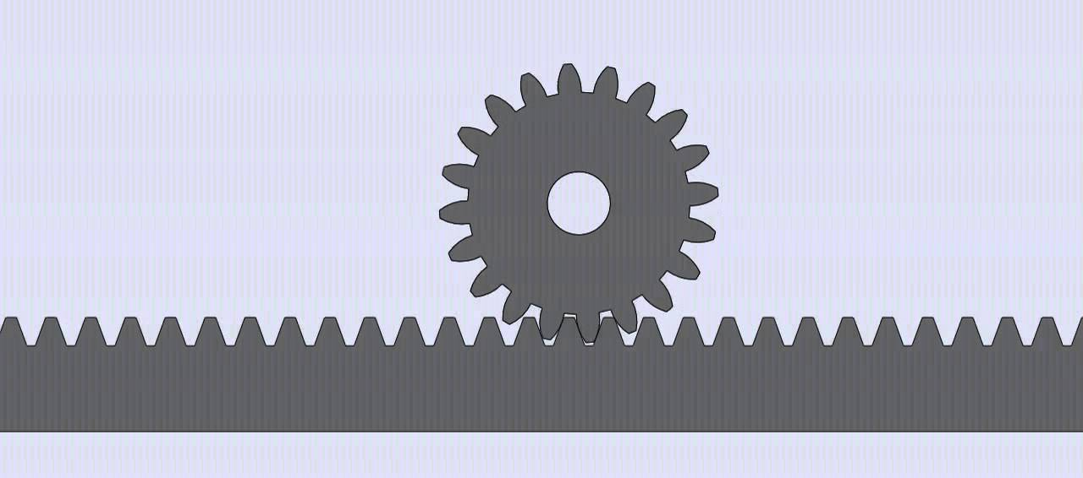
What is Rack & Pinion
Pinion
Rack

Slide 12
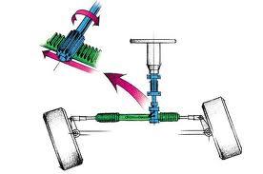
Rack & Pinion as steering mech.

Slide 13
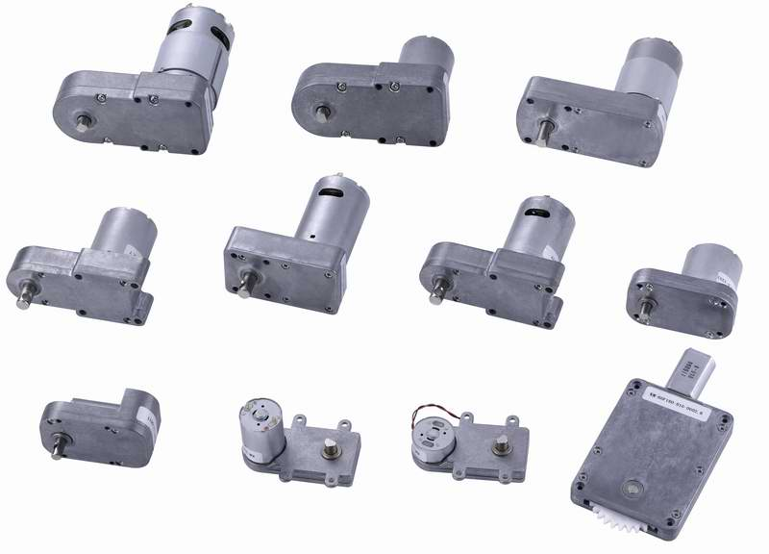
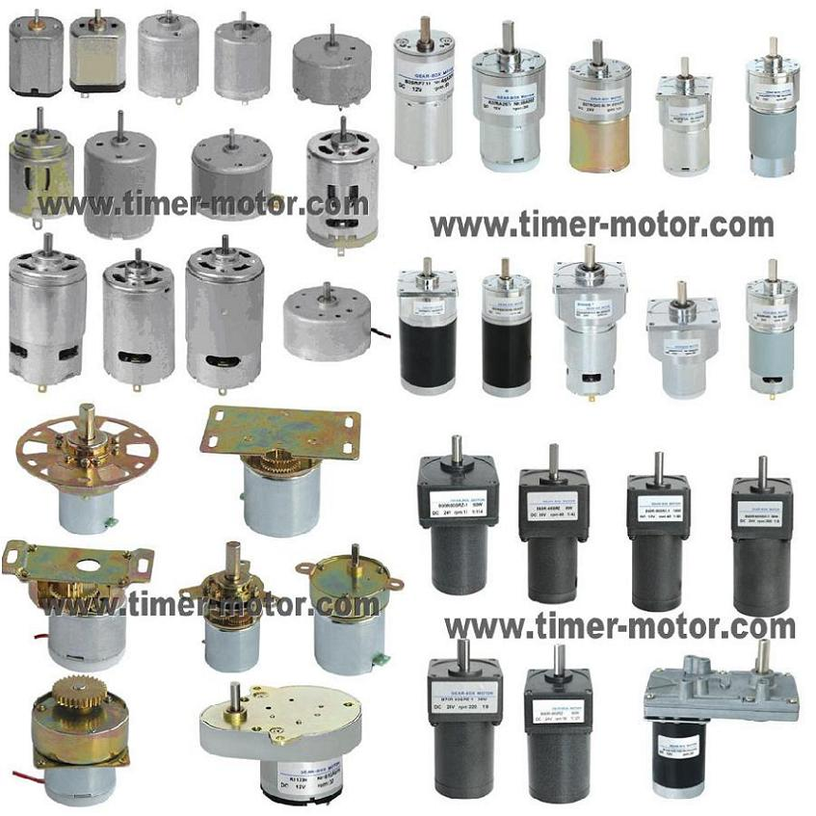
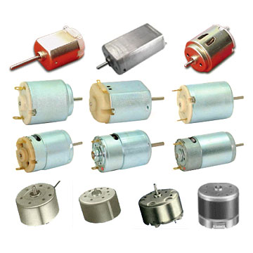
MOTORS

Slide 14
MOTORS
Choosing the motors is a very big task as a wide variety of motors of different r.p.m , torque, size, power, weight, material are available in the market .
There is always a tradeoff while selecting the motors as torque and r.p.m are inversely proportional for given power.
P = τ*ω
It is suggested to use motors of rpm between 150-300.
Higher rpm motors are difficult to control.
Cost is always a contributing factor.

Slide 15
Types of motors
Plastic BO motors are used if the bot needs to be light weight but they have a weak shaft and lesser torque.
Metal motors are heavy but strong and reliable gears. (Most preferred)
Servo motors: (Not needed in XLR8)
Can rotate to specified angles.
Can rotate only between 0-180 degree.
Highly accurate.
Needs microcontroller to control.

Slide 16
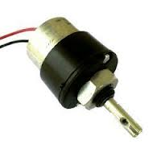
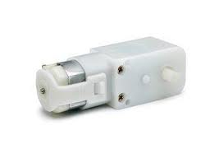
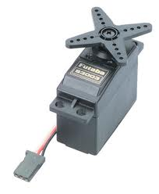
Metal
DC motor
BO motor
Servo motor

Slide 17
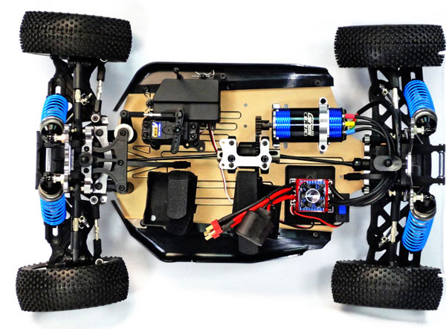
Material for chassis
Acrylic
Aluminum
Wood

Slide 18
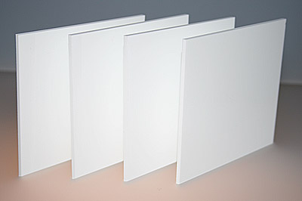
Acrylic
Advantages
Light weight.
Easy to work with. (cut & drill)
Transparent sheets are available which can be used in robots where internal mechanism are to be displayed.

Slide 19
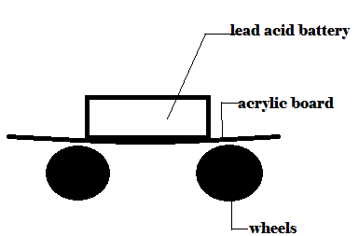
Disadvantages
On application of
load it bends.
Brittle & fragile.
Not able to sustain shocks and powerful jerks during impact or jumps.
Not reliable for long term usage of machine.

Slide 20
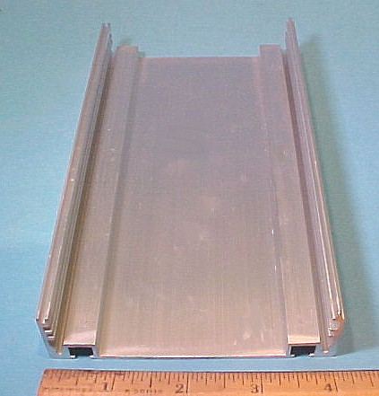
Aluminum
Advantage
Light weight
Easy milling (compared to other metals)
Readymade sections, bars, boxes etc are easily available in the market which can be directly used
More strength to weight ratio
Disadvantage
Sheet of same dimension is very heavy as compared to rest of the two materials

Slide 21
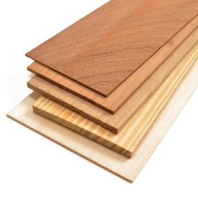
Wood
Advantages
Lightest among the three
Relatively cheaper than acrylic
Easy to work with.
Disadvantages
Weaker than aluminum.
Not Waterproof.

Slide 22
Battery
We generally use 4 types of batteries.
Lead-acid battery – Rechargeable, generally used
Lithium Ion (Li-ion) battery.
Lithium Polymer (li-po)
Nickel Metal Hydride (Ni-MH) battery.

Slide 23
Which battery to use?
Lead acid batteries- Heavy , cheap, easy and safe to use.
Lithium ion battery-light weight , costly , careful charging needed.
Lithium polymer- light weight , very costly , careful charging and balancing needed.
Nickel metal hydride-slightly heavy , safe to use.

Slide 24
Thank You

Slide 25
Doubts?

